Slide 1
Basic Discrete Structure : Function
Lecture 7-8
Notes:
‹#›

Slide 2
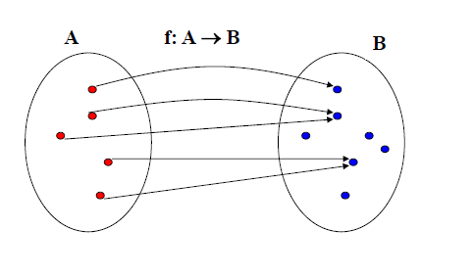
Function
Definition: Let A and B be two sets. A function from A to B, denoted f : A → B , is an assignment of exactly one element of B to each element of A. We write f(a) = b to denote the assignment of b to an element a of A by the function f.
Notes:
‹#›

Slide 3
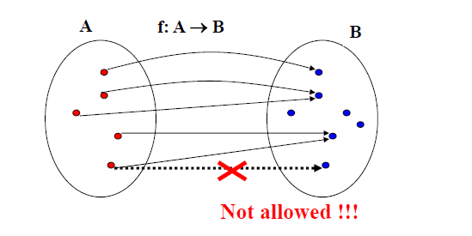
Function
Definition: Let A and B be two sets. A function from A to B, denoted f : A → B , is an assignment of exactly one element of B to each element of A. We write f(a) = b to denote the assignment of b to an element a of A by the function f.
Notes:
‹#›

Slide 4
Representing Function
Representations of functions:
1. Explicitly state the assignments in between elements of the two sets
2. Compactly by a formula. (using ‘standard’ functions)
Example1:
• Let A = {1,2,3} and B = {a,b,c}
• Assume f is defined as:
• 1 → c
• 2 → a
• 3 → c
• Is f a function ?
• Yes. since f(1)=c, f(2)=a, f(3)=c. each element of A is assigned an element from B
Notes:
‹#›

Slide 5
Representing Function
Representations of functions:
1. Explicitly state the assignments in between elements of the
two sets
2. Compactly by a formula. (using ‘standard’ functions)
Example 2:
• Let A = {1,2,3} and B = {a,b,c}
• Assume g is defined as:
• 1 → c
1 → b
• 2 → a
• 3 → c
• Is g a function ?
Notes:
‹#›

Slide 6
Representing Function
Representations of functions:
1. Explicitly state the assignments in between elements of the
two sets
2. Compactly by a formula. (using ‘standard’ functions)
Example 2:
• Let A = {1,2,3} and B = {a,b,c}
• Assume g is defined as:
• 1 → c
1 → b
• 2 → a
• 3 → c
• Is g a function ?
• No. since g(1) is assigned both c and b.
Notes:
‹#›

Slide 7
Representing Function
Representations of functions:
1. Explicitly state the assignments in between elements of the
two sets
2. Compactly by a formula. (using ‘standard’ functions)
Example 3:
• A = {0,1,2,3,4,5,6,7,8,9}, B = {0,1,2}
• Define h: A → B as:
h(x) = x mod 3.
• (the result is the remainder after the division by 3)
• Assignments:
• 0 →0 3 → 0
• 1 → 1 4 → 1
• 2 → 2 …
Notes:
‹#›

Slide 8
Notation of Set
Definitions: Let f be a function from A to B.
• We say that A is the domain of f and B is the codomain of f.
• If f(a) = b, b is the image of a and a is a pre-image of b.
• The range of f is the set of all images of elements of A. Also, if
f is a function from A to B, we say f maps A to B.
Example: Let A = {1,2,3} and B = {a,b,c}
• Assume f is defined as: 1 → c, 2 → a, 3 → c
• What is the image of 1?
• 1 → c c is the image of 1
• What is the pre-image of a?
• 2 → a 2 is a pre-image of a.
• Domain of f ? {1,2,3}
• Codomain of f ? {a,b,c}
• Range of f ? {a,c}
Notes:
‹#›

Slide 9
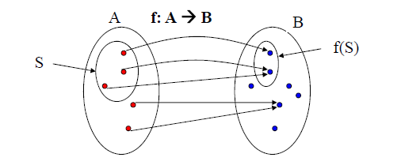
Image of subset
Definition: Let f be a function from set A to set B and let S be a
subset of A. The image of S is a subset of B that consists of the
images of the elements of S. We denote the image of S by f(S),
so that f(S) = { f(s) | s ϵ S }.
Example:
• Let A = {1,2,3} and B = {a,b,c} and f: 1 → c, 2 → a, 3 → c
• Let S = {1,3} then image f(S) = ?
Notes:
‹#›

Slide 10
Image of subset
Definition: Let f be a function from set A to set B and let S be a
subset of A. The image of S is a subset of B that consists of the
images of the elements of S. We denote the image of S by f(S),
so that f(S) = { f(s) | s ϵ S }.
Example:
• Let A = {1,2,3} and B = {a,b,c} and f: 1 → c, 2 → a, 3 → c
• Let S = {1,3} then image f(S) = {c}
Notes:
‹#›

Slide 11
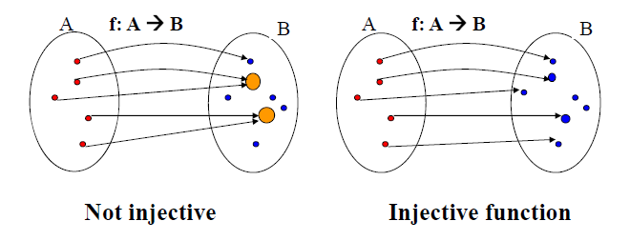
Injective function
Definition: A function f is said to be one-to-one, or injective, if
and only if f(x) = f(y) implies x = y for all x, y in the domain of
f. A function is said to be an injection if it is one-to-one.
A function for which every element of the range of the function corresponds to exactly one element of the domain.
Notes:
‹#›

Slide 12
Injective function
Example 1: Let A = {1,2,3} and B = {a,b,c}
• Define f as
– 1 → c
– 2 → a
– 3 → c
• Is f one to one?
Notes:
‹#›

Slide 13
Injective function
Example 1: Let A = {1,2,3} and B = {a,b,c}
• Define f as
– 1 → c
– 2 → a
– 3 → c
• Is f one to one?
No, it is not one-to-one
since f(1) = f(3) = c, and 1 ≠ 3.
Example 2: Let g : Z →Z, where g(x) = 2x - 1.
• Is g one-to-one?
Notes:
‹#›

Slide 14
Injective function
Example 1: Let A = {1,2,3} and B = {a,b,c}
• Define f as
– 1 → c
– 2 → a
– 3 → c
• Is f one to one?
No, it is not one-to-one
since f(1) = f(3) = c, and 1 ≠ 3.
Example 2: Let g : Z →Z, where g(x) = 2x - 1.
• Is g is one-to-one?
• Yes.
• Why? g(a) = g(b), i.e., 2a - 1 = 2b - 1 => 2a = 2b=> a = b.
Notes:
‹#›

Slide 15
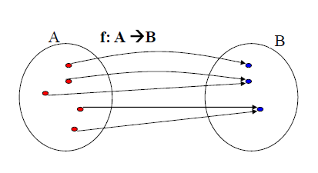
Surjective function
Definition: A function f from A to B is called onto, or surjective, if and only if for every b ϵ B there is an element a ϵ A such that f(a) = b.
Alternative: all co-domain elements are covered
Notes:
‹#›

Slide 16
Surjective function
Example 1: Let A = {1,2,3} and B = {a,b,c}
– Define f as
• 1 → c
• 2 → a
• 3 → c
• Is f an onto?
Notes:
‹#›

Slide 17
Surjective function
Example 1: Let A = {1,2,3} and B = {a,b,c}
– Define f as
• 1 → c
• 2 → a
• 3 → c
• Is f an onto?
• No. f is not onto, since b ϵ B has no pre-image.
Example 2: A = {0,1,2,3,4,5,6,7,8,9}, B = {0,1,2}
– Define h: A → B as h(x) = x mod 3.
• Is h an onto function?
Notes:
‹#›

Slide 18
Surjective function
Example 1: Let A = {1,2,3} and B = {a,b,c}
– Define f as
• 1 → c
• 2 → a
• 3 → c
• Is f an onto?
• No. f is not onto, since b ϵ B has no pre-image.
Example 2: A = {0,1,2,3,4,5,6,7,8,9}, B = {0,1,2}
– Define h: A → B as h(x) = x mod 3.
• Is h an onto function?
• Yes. h is onto since a pre-image of 0 is 6, a pre-image of 1 is 4, a pre-image of 2 is 8.
Notes:
‹#›

Slide 19
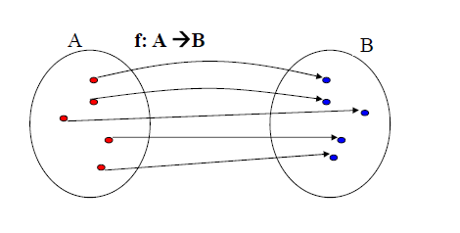
Bijective function
Definition: A function f is called a bijection if it is both one-to one and onto.
onto
One to one and onto
Notes:
‹#›

Slide 20
Bijective function
Example 1:
• Let A = {1,2,3} and B = {a,b,c}
– Define f as
• 1 → c
• 2 → a
• 3 → b
• Is f a bijection?
Notes:
‹#›

Slide 21
Bijective function
Example 1:
• Let A = {1,2,3} and B = {a,b,c}
– Define f as
• 1 → c
• 2 → a
• 3 → b
• Is f is a bijection? Yes. It is both one-to-one and onto.
• Note: Let f be a function from a set A to itself, where A is finite. f is one-to-one if and only if f is onto.
• This is not true if A an infinite set. Define f : Z → Z, where
f(z) = 2 * z. f is one-to-one but not onto (3 has no pre-image).
Notes:
‹#›

Slide 22
Bijective function
Example 2:
• Define g : W → W (whole numbers), where
g(n) = [n/2] (floor function).
• 0 → [0/2] = [0] = 0
• 1 → [1/2] = [1/2] = 0
• 2 → [2/2] = [1] = 1
• 3 → [3/2] = [3/2] = 1
• ...
• Is g a bijection?
– No. g is onto but not 1-1 (g(0) = g(1) = 0 however 0 ≠ 1.
Notes:
‹#›

Slide 23
Bijective function
Theorem: Let f be a function f: A → A from a set A to itself,
where A is finite. Then f is one-to-one if and only if f is onto.
Assume
A is finite and f is one-to-one (injective)
• Is f an onto function (surjection)?.
Notes:
‹#›

Slide 24
Bijective function
Theorem: Let f be a function f: A → A from a set A to itself,
where A is finite. Then f is one-to-one if and only if f is onto.
Proof:
→ A is finite and f is one-to-one (injective)
• Is f an onto function (surjection)?
• Yes. Every element points to exactly one element. Injection
assures they are different. So we have |A| different elements A points to. Since f: A → A the co-domain is covered thus the
function is also a surjection (and a bijection)
← A is finite and f is an onto function
• Is the function one-to-one?
Notes:
‹#›

Slide 25
Bijective function
Theorem: Let f be a function f: A → A from a set A to itself,
where A is finite. Then f is one-to-one if and only if f is onto.
← A is finite and f is an onto function
• Is the function one-to-one?
Yes. Every element maps to exactly one element and all
elements in A are covered. Thus the mapping must be one-to one
Notes:
‹#›

Slide 26
Bijective function
Theorem. Let f be a function from a set A to itself, where A is finite. Then f is one-to-one if and only if f is onto.
Please note the above is not true when A is an infinite set.
• Example:
– f : Z → Z, where f(z) = 2 * z.
– f is one-to-one but not onto.
• 1 → 2
• 2 → 4
• 3 → 6
– 3 has no pre-image.
Notes:
‹#›

Slide 27
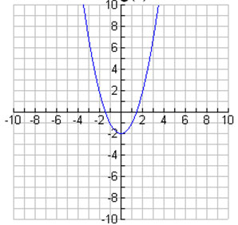
Function on Real Number
Is g (x) = x² - 2 onto where R → R?

Slide 28
Function on Real Number
Is g (x) = x² - 2 onto where R → R?
No, Values less than -2 on the y-axis are never used.
Is it one to one?

Slide 29
Function on Real Number
Is g (x) = x² - 2 onto where R → R?
No, Values less than -2 on the y-axis are never used.
Is it one to one?
No, pair value of x for each y value

Slide 30
Function on Real Number
Definition: Let f1 and f2 be functions from A to R (reals). Then
f1 + f2 and f1 * f2 are also functions from A to R defined by
• (f1 + f2)(x) = f1(x) + f2(x)
• (f1 * f2)(x) = f1(x) * f2(x).
Examples:
• Assume
• f1(x) = x - 1
• f2(x) = x³ + 1
then
• (f1 + f2)(x) = x³ + x
• (f1 * f2)(x) = x⁴ - x³ + x - 1
Notes:
‹#›

Slide 31
Increasing and Decreasing Function
Definition: A function f whose domain and codomain are subsets of real numbers is strictly increasing if f(x) > f(y) whenever x > y and x and y are in the domain of f.
Similarly, f is called strictly decreasing if f(x) < f(y) whenever x > y and x and y are in the domain of f.
Example:
• Let g : R → R, where g(x) = 2x - 1. Is it increasing ?
Notes:
‹#›

Slide 32
Increasing and Decreasing Function
Definition: A function f whose domain and codomain are subsets of real numbers is strictly increasing if f(x) > f(y) whenever x > y and x and y are in the domain of f.
Similarly, f is called strictly decreasing if f(x) < f(y) whenever x > y and x and y are in the domain of f.
Example:
• Let g : R → R, where g(x) = 2x - 1. Is it increasing ?
Proof .
For x>y holds 2x > 2y and subsequently 2x-1 > 2y-1
Thus g is strictly increasing.
Notes:
‹#›

Slide 33
Increasing and Decreasing Function
Definition: A function f whose domain and codomain are subsets of real numbers is strictly increasing if f(x) > f(y) whenever x > y and x and y are in the domain of f.
Similarly, f is called strictly decreasing if f(x) < f(y) whenever x > y and x and y are in the domain of f.
Note: Strictly increasing and strictly decreasing functions are one-to-one.
Why?
Notes:
‹#›

Slide 34
Increasing and Decreasing Function
Definition: A function f whose domain and codomain are subsets of real numbers is strictly increasing if f(x) > f(y) whenever x > y and x and y are in the domain of f.
Similarly, f is called strictly decreasing if f(x) < f(y) whenever x > y and x and y are in the domain of f.
Note: Strictly increasing and strictly decreasing functions are one-to-one.
Why?
One-to-one function: A function is one-to-one if and only if f(x) ≠ f(y), whenever x ≠ y.
Notes:
‹#›

Slide 35
Identity function
Definition: Let A be a set. The identity function on A is the
function i_{A}: A → A where i_{A} (x) = x.
Example:
• Let A = {1,2,3}
Then:
• i_{A} (1) = ?
Notes:
‹#›

Slide 36
Identity function
Definition: Let A be a set. The identity function on A is the
function i_{A}: A → A where i_{A} (x) = x.
Example:
• Let A = {1,2,3}
Then:
• i_{A} (1) = 1
• i_{A} (2) = 2
• i_{A} (3) = 3.
Notes:
‹#›

Slide 37
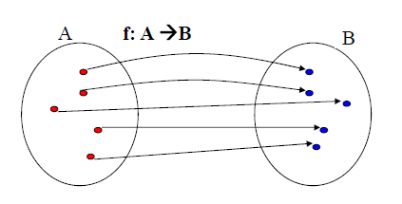
Bijective Function
Definition: A function f is called a bijection if it is both one-to one and onto.
Notes:
‹#›

Slide 38
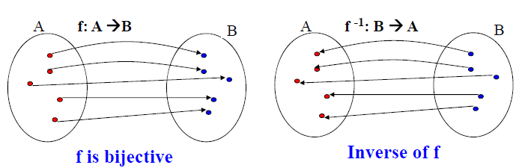
Inverse Function
Definition: Let f be a bijection from set A to set B. The inverse
function of f is the function that assigns to an element b from B
the unique element a in A such that f(a) = b.
The inverse function of f is denoted by f⁻¹. Hence, f⁻¹ (b) = a, when f(a) = b. If the inverse function of f exists, f is called invertible.
Notes:
‹#›

Slide 39
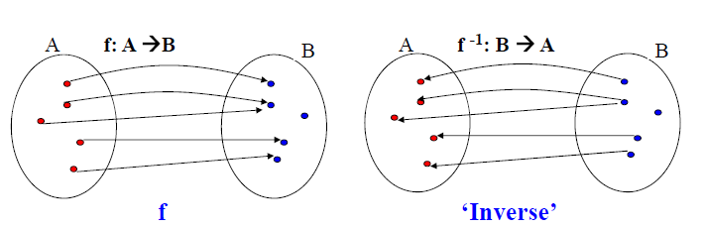
Inverse Function
Note: if f is not a bijection then it is not possible to define the
inverse function of f. Why?
Assume f is not one-to-one:
?
Notes:
‹#›

Slide 40
Inverse Function
Note: if f is not a bijection then it is not possible to define the
inverse function of f. Why?
Assume f is not one-to-one:
Inverse is not a function. One element of B is mapped to two
different elements.
Notes:
‹#›

Slide 41
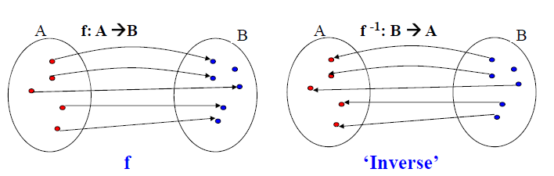
Inverse Function
Note: if f is not a bijection then it is not possible to define the
inverse function of f. Why?
Assume f is not onto:
?
Notes:
‹#›

Slide 42
Inverse Function
Note: if f is not a bijection then it is not possible to define the
inverse function of f. Why?
Assume f is not onto:
Inverse is not a function. One element of B is not assigned any
value in A.
Notes:
‹#›

Slide 43
Inverse Function
Example 1:
• Let A = {1,2,3} and i_{A} be the identity function
• i_{A}(1) = 1 i_{A}⁻¹ (1) = 1
• i_{A}(2) = 2 i_{A}⁻¹ (2) = 2
• i_{A}(3) = 3 i_{A}⁻¹ (3) = 3
• Therefore, the inverse function of i_{A} is i_{A}.
Notes:
‹#›

Slide 44
Inverse Function
Example 2:
• Let g : R → R, where g(x) = 2x - 1.
• What is the inverse function g⁻¹ ?
Notes:
‹#›

Slide 45
Inverse Function
Example 2:
• Let g : R → R, where g(x) = 2x - 1.
• What is the inverse function g⁻¹ ?
Approach to determine the inverse:
y = 2x - 1 => y + 1 = 2x
=> (y+1)/2 = x
• Define g⁻¹(y) = x= (y+1)/2
Test the correctness of inverse:
• g(3) = ..
Notes:
‹#›

Slide 46
Inverse Function
Example 2:
• Let g : R → R, where g(x) = 2x - 1.
• What is the inverse function g⁻¹ ?
Approach to determine the inverse:
y = 2x - 1 => y + 1 = 2x
=> (y+1)/2 = x
• Define g⁻¹(y) = x= (y+1)/2
Test the correctness of inverse:
• g(3) = 2*3 - 1 = 5
• g⁻¹ (5) =
Notes:
‹#›

Slide 47
Inverse Function
Example 2:
• Let g : R → R, where g(x) = 2x - 1.
• What is the inverse function g⁻¹ ?
Approach to determine the inverse:
y = 2x - 1 => y + 1 = 2x
=> (y+1)/2 = x
• Define g⁻¹(y) = x= (y+1)/2
Test the correctness of inverse:
• g(3) = 2*3 - 1 = 5
• g⁻¹ (5) = (5+1)/2 = 3
Notes:
‹#›

Slide 48
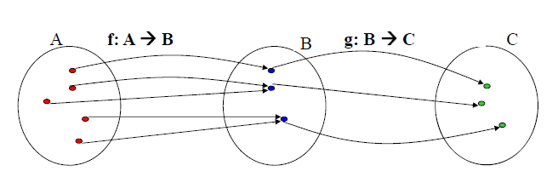
Composition of Function
Definition: Let f be a function from set A to set B and let g be a
function from set B to set C. The composition of the functions
g and f, denoted by g O f is defined by (g O f)(a) = g(f(a)).
Notes:
‹#›

Slide 49
Composition of Function
Example 1:
• Let A = {1,2,3} and B = {a,b,c,d}
g : A → A, f: A → B
1 →3 1 → b
2 →1 2 → a
3 →2 3 → d
Notes:
‹#›

Slide 50
Composition of Function
Example 1:
• Let A = {1,2,3} and B = {a,b,c,d}
g : A → A, f: A → B
1 →3 1 → b
2 →1 2 → a
3 →2 3 → d
g O f : A → B:
• 1 → d
2 → b
3 → a
Notes:
‹#›

Slide 51
Composition of Function
Example 2:
• Let f and g be two functions from Z to Z, where
f(x) = 2x and g(x) = x².
• f O g : Z → Z
• (f O g)(x) = f(g(x))
= f( x² )
= 2(x²)
• g O f : Z → Z
• (g O f)(x) = ?
Notes:
‹#›

Slide 52
Composition of Function
Example 2:
• Let f and g be two functions from Z to Z, where
f(x) = 2x and g(x) = x².
• f O g : Z → Z
• (f O g)(x) = f(g(x))
= f( x² )
= 2(x²)
• g O f : Z → Z
• (g O f)(x) = g(f(x))
= g(2x)
= 4x²
Notes:
‹#›

Slide 53
Composition of Function
Example 3:
• (f O f ⁻¹)(x) = x and (f ⁻¹ O f)(x) = x, for all x.
• Let f : R → R, where f(x) = 2x – 1 and f ⁻¹ (x) = (x+1)/2.
• (f O f ⁻¹ )(x) = f(f ⁻¹ (x))
= f( (x+1)/2 )
= 2( (x+1)/2 ) - 1
= (x+1) - 1
= x
Notes:
‹#›

Slide 54
Composition of Function
Example 3:
• (f O f ⁻¹)(x) = x and (f ⁻¹ O f)(x) = x, for all x.
• Let f : R → R, where f(x) = 2x – 1 and f ⁻¹ (x) = (x+1)/2.
• (f O f ⁻¹ )(x) = f(f ⁻¹ (x))
= f( (x+1)/2 )
= 2( (x+1)/2 ) - 1
= (x+1) - 1
= x
(f ⁻¹ O f)(x) = f ⁻¹ (f(x))
= f ⁻¹ ( 2x - 1 )
= (2x)/2
= x
Notes:
‹#›

Slide 55


Some Function
Definitions:
• The floor function assigns a real number x the largest integer
that is less than or equal to x. The floor function is denoted by
.
• The ceiling function assigns to the real number x the smallest
integer that is greater than or equal to x. The ceiling function is
denoted by
Other important functions:
• Factorials: n! = n(n-1) such that 1! = 1
Notes:
‹#›

Slide 56
Thank You

